Slide 1

Online Grocery Store System

Slide 2
Agenda
Introduction
Technology Stack
System Architecture
Module Functionalities
Database Schema
Advantages
Conclusion

Slide 3

Introduction
Develop a web-based Online Grocery Store for customers to browse, purchase, and manage grocery items.
The system supports customers in searching for products, placing orders, and tracking deliveries.
Administrators can manage inventory, process orders, and monitor customer activity.

Slide 4
Technology Stack
Front-End: Angular
Server-side: Spring Boot.
Back-end: MYSQL, Hibernate.
Server: Tomcat

Slide 5
System Architecture
Customer Portal: User interface for customers to interact with the store.
Administrator Dashboard: Backend for administrators to manage store operations.
Admin Dashboard: Tools for delivery personnel to handle deliveries.

Slide 6
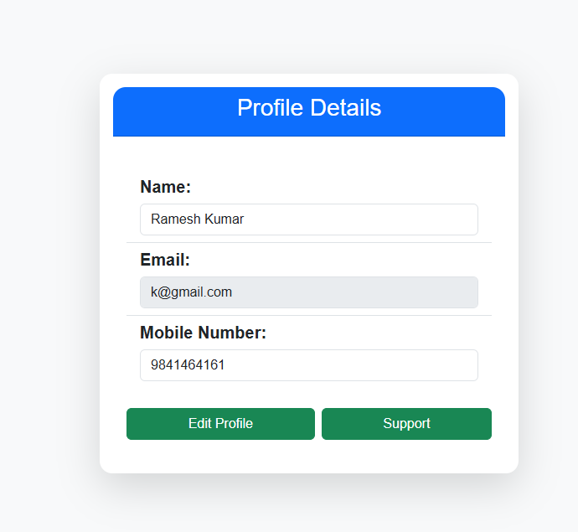
Customer Portal
Functionalities
Browse Products: Search by category, price, or keywords; view product details.
Add to Cart & Checkout: Add items to cart and select delivery options.
Profile Management: Update personal info.

Slide 7
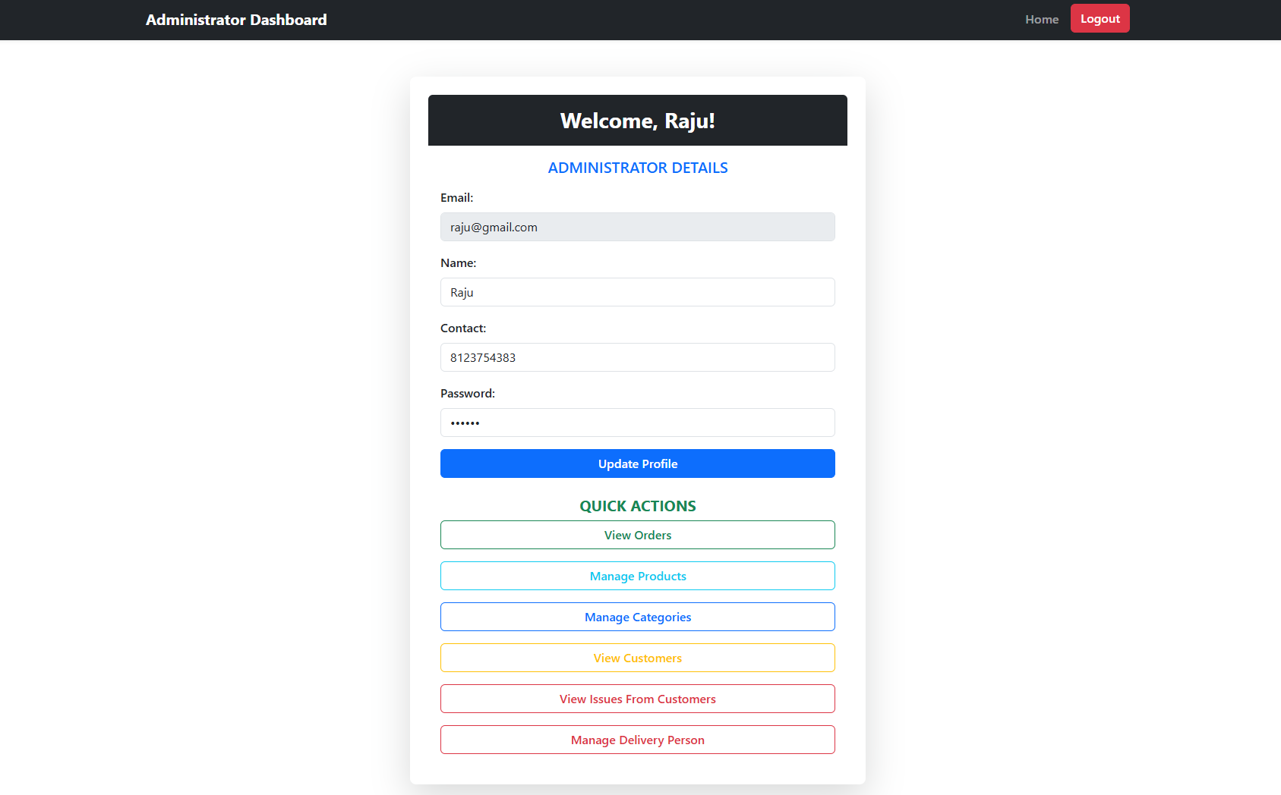
Administrator Dashboard Features
Functionalities
Product Management: Add, update, or remove products; manage prices and stock levels.
Order Management: Process and track customer orders.
Sales & Reports: Generate sales and inventory reports.
Customer Support: Handle inquiries, issues, or complaints.

Slide 8
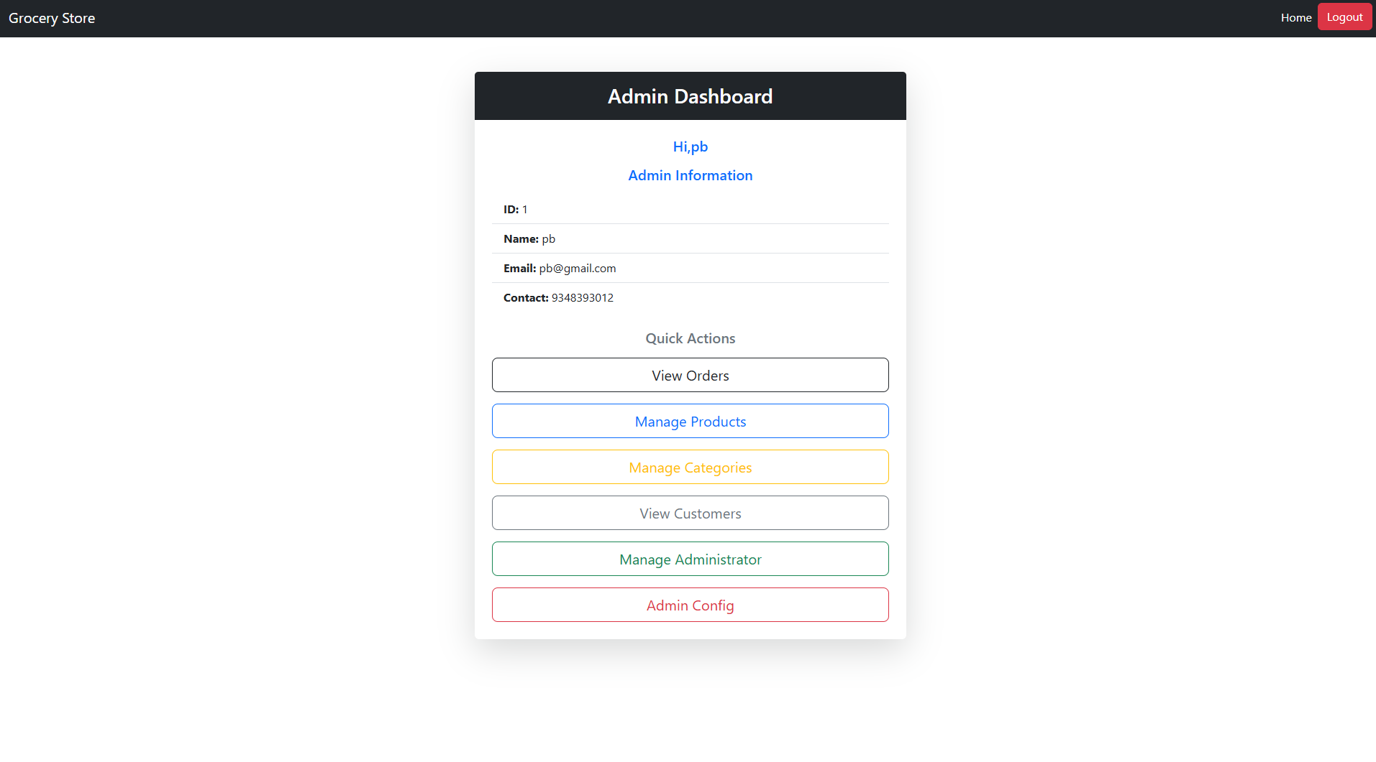
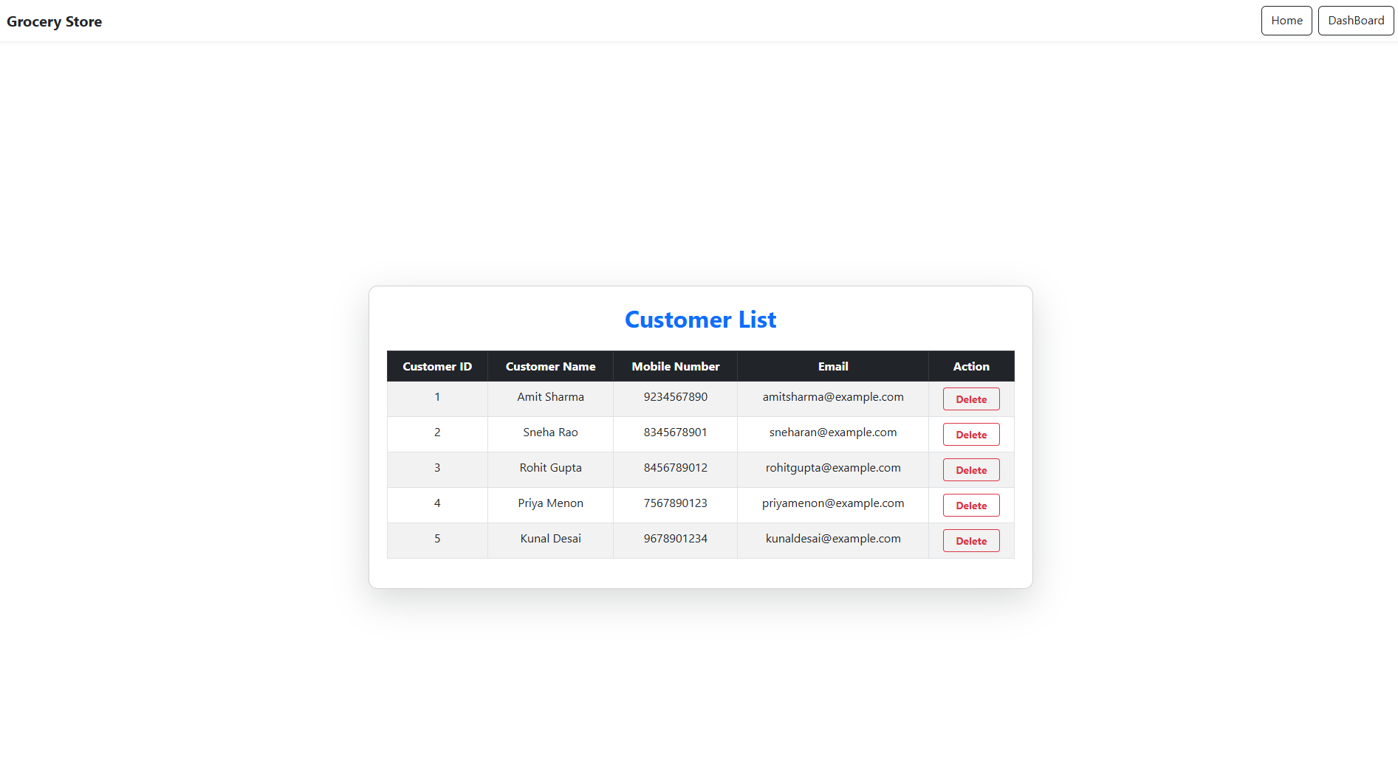
Admin Portal
Functionalities
User Role Management: Manage user accounts, roles, and permissions.
Administrator Management: Manage Administrator.
Order: Can view orders reports

Slide 9
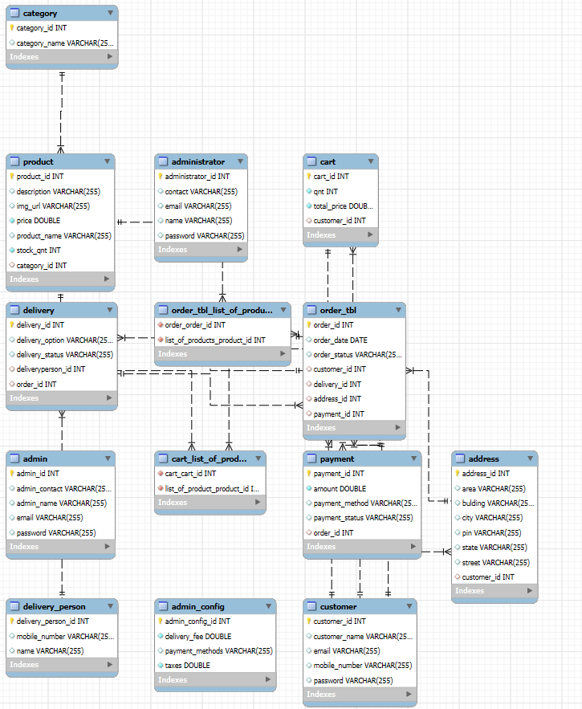
Database Schema

Slide 10
Advantages
Customer Convenience: Seamless shopping experience with easy navigation and order tracking.
Efficient Management: Streamlines inventory, order processing, and customer support.
Optimized Deliveries: Enables efficient management.

Slide 11
Conclusion
Summary
The Online Grocery Store aims to revolutionize grocery shopping by integrating advanced functionalities.
Provides a user-friendly interface for customers, administrators, and delivery personnel.
Ensures efficient operations and high customer satisfaction.

Slide 12

Thank You

